Slide 1
Internet
Control
Message
Protocol
Karki Gaurav
Tanada Alexander Ryu
Tanada Michael Hiro
Kozich Dziyana
Gandi
Grebinnyi Anton

Slide 2
Contents
1
2
3
4
What is ICMP?
How does ICMP work?
ICMP message
classification
ICMP issues
The definition of ICMP
Where it is used?
What is it used for?
The principle of work
ICMP Parameters
ICMP Message Format
Destination Unreachable
Time Exceeded
Parameter Problem
Source quench
Redirect
Echo and echo reply
Timestamp request/reply
Router advertisement/solicitation
Definition of DDoS Attack
Ping of Death Attack
Smurf Attack
Flood Attack
Karki Gaurav

Slide 3
1
What is
ICMP ?

Slide 4
Karki Gaurav
OSI model
Protocols
TCP/IP model
Layer 7
Application
FTP
SMTP
POP3
Telnet
SNMP
MS
Network
Client
Other
NetBIOS
Application
Layer 6
Application
Layer 4
Presentation
SSL
ASCII
Layer 5
Session
Sockets
NetBIOS
Layer 4
Transport
UDP
TCP
Host-to-Host
Layer 3
Layer 3
Network
ICMP
IGMP
IP
Internet
Layer 2
Layer 2
Data Link
Layer 1
Physical
Network
Interface
Layer 1
Physical

Slide 5
When something unexpected occurs during packet processing at a router, the event is reported to the sender by the ICMP (Internet Control Message Protocol).
ICMP is also used to test the Internet.
About a dozen types of ICMP messages are defined.
Each ICMP message type is carried encapsulated in an IP packet.
Karki Gaurav

Slide 6
How does ICMP work?
2

Slide 7
32 bits
8
8
8
8
Header
Length
Version
Type of Service
Total Length
Identifier
Flags
Fragment Offset
IP
Header
Time to Live
Protocol
Header Checksum
IP
Packet
Source Address
Destination Address
ICMP
Header
Type
Code
ICMP Checksum
Data
ICMP Packet Structure
Tanada Alexander Ryu

Slide 8
How ICMP works
Triggering Event: The ICMP is invoked when there is an issue with the network.
Creating ICMP Message: When encountering an issue with the network, the source device generates ICMP message. Then, the ICMP message is encapsulated in an IP packet.
Sending The ICMP Packet: The packet is sent to the destination device or router using the path where the issue occurred. The destination device or router receives and processes the ICMP message.
ICMP Processing: The destination device checks the code on the ICMP header to determine the issue and determines the appropriate action.
Triggering
Creating
Sending
Processing
Tanada Alexander Ryu

Slide 9
ICMP Parameters
It exist in the packet header to help identify the errors in the IP packet.
Every ICMP message’s packet header contains three parameters, it is located on the first 32 bits.
Type
Code
Checksum
Tanada Alexander Ryu

Slide 10
ICMP Type | Code | Description
0 | 0 | Echo Reply
3 | 0 | Destination network Unreachable
3 | 1 | Destination Host Unreachable
3 | 2 | Destination Protocol Unreachable
3 | 7 | Destination Host Unknown
8 | 0 | Echo Request
10 | 0 | Router Discovery
11 | 0 | TTL expired
8 |  | 0
1 |  | 9
TEST
Type
Code
Checksum
Specifies the general category or purpose of the ICMP message. There are various ICMP message types.
Provides more specific details about the message
Used to measure the integrity of the ICMP message. It uses the header and the content of the message to calculate checksum
8 & 0
0
1
9
T & E
S & T
Sum
Checksum
00001000 00000000
00000000 00000000
00000000 00000001
00000000 00001001
01010100 01000101
01010011 01010100
10101111 10100011
01010000 01011100
8 bits
8 bits
16 bits
32 bits
Tanada Alexander Ryu

Slide 11
ICMP Message Types
3

Slide 12
Destination Unreachable
Tanada Michael Hiro
{
}
The host/router sends this message if it is not able to route the IP packet to its destination. It can occur from various reasons, such as absence of a valid route, network congestion, or a firewall rule blocking the packet
Link failure
Hardware failure
Port failure
S
1
2
3
D
4
Ex. If sender A wants to send the packet to receiver B, but it is not received by B, then the intermediate router will discard the packet and send the destination unreachable message to A

Slide 13
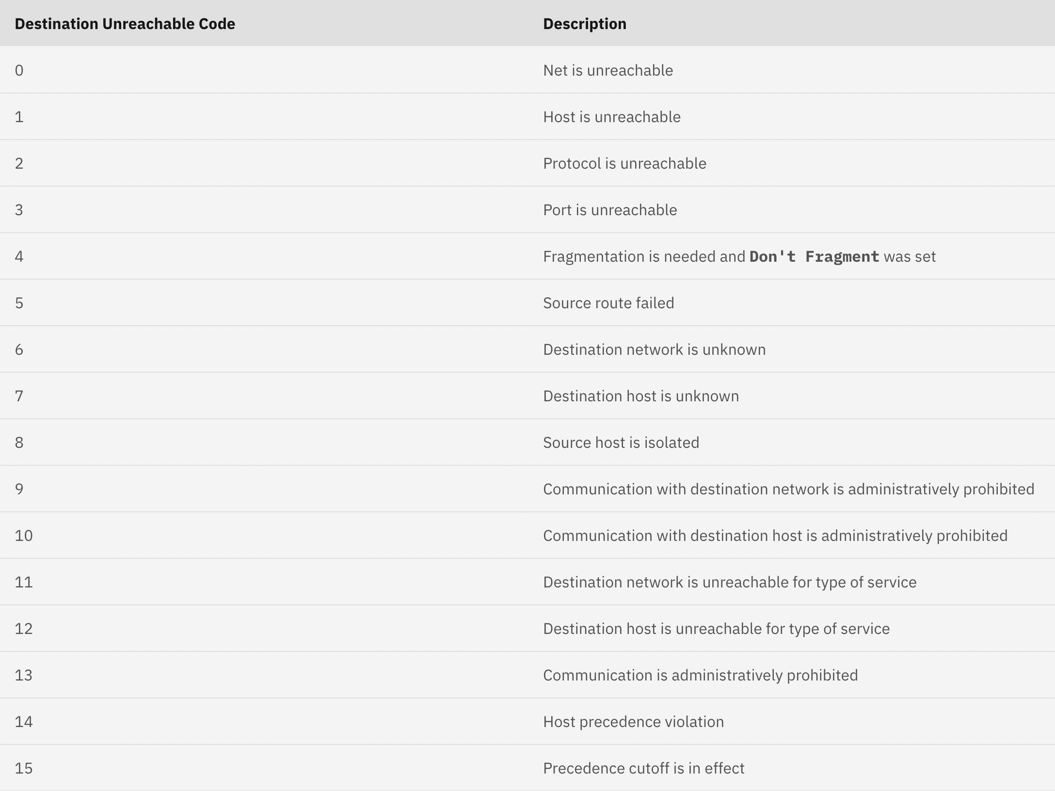
Tanada Michael Hiro

Slide 14
Time Exceeded
Tanada Michael Hiro
{
}
The host/router sends this message if it decrements the time-to-live (TTL) value of a datagram reaches zero, which prevents the packet from reaching it destination. Another condition is if the destination address does not receive all the packets in the specified time interval.
Host A
TTL - 1
Host B
Router 1
Router 2
ICMP Time
Exceeded
Host A
TTL - 2
TTL - 1
Host B
Router 1
Router 2
ICMP Time Exceeded
Host A
TTL - 3
TTL - 2
TTL - 1
Host B
Router 1
Router 2
ICMP Echo Reply
Ex. A packet is sent from a layer having 1000 units to a layer having 200 units, then the packet is divided into five fragments. If all the fragments don’t reach the destination in a set time, all fragments are discarded and the time-exceeded message is sent to the source.

Slide 15
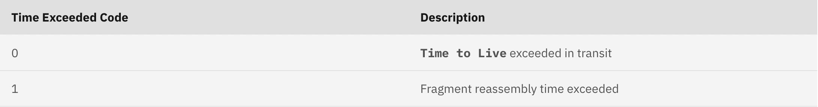
Tanada Michael Hiro

Slide 16
Parameter Problem
Tanada Michael Hiro
{
Parameter Problem messages are used to indicate that a host or router could not interpret an invalid parameter in an IPv4 datagram header.
When a host or router on the network find a bad parameter in an IPv4 datagram header, it will drop the packet and send an ICMP Parameter Problem message to the original sender. ICMP Parameter Problem message also has an option for a special pointer to inform the sender where in the original IPv4 header the error had occurred.
}
Noise modified IP header
(check the checksum）
S
3
4
5
D
6

Slide 17
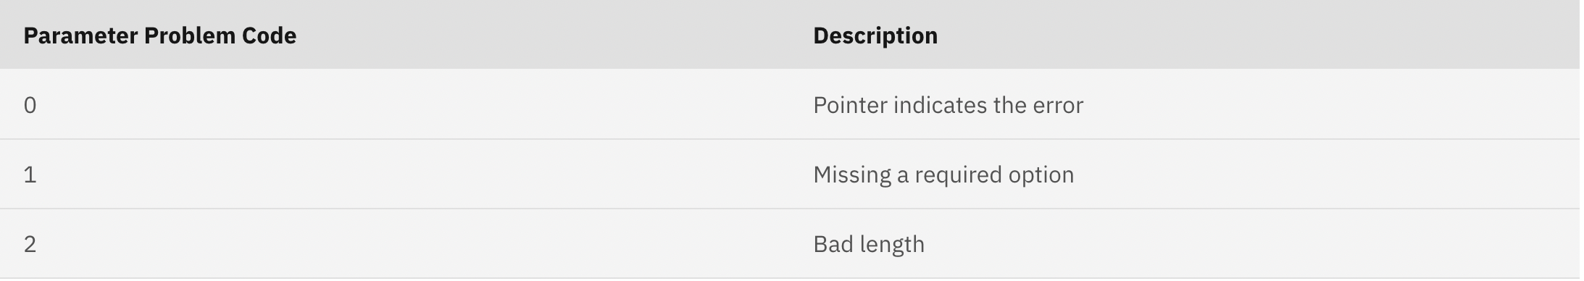
Tanada Michael Hiro

Slide 18
Kozich Dziyana
Source Quench
{
}
Was long ago used to throttle hosts that were sending too many packets. When a host received this message, it was expected to slow down.
Source host receives the message and adjusts transmission rate
Start
Traffic Overload is detected?
Generate ICMP Source Quench Message
Send the message to Source Host

Slide 19











Slide 20
Redirection
Kozich Dziyana
}
{
Redirect requests data packets are sent on an alternate route. The message informs a host to update its routing information (to send packets on an alternate route).
Host A receives the message, updates routing table and redirects Data Packet to better path
Router receives Data Packet from Host A and determines better Path via ICMP Redirect
Start
Router Generates Redirect Message
Router sends the message to Host A

Slide 21

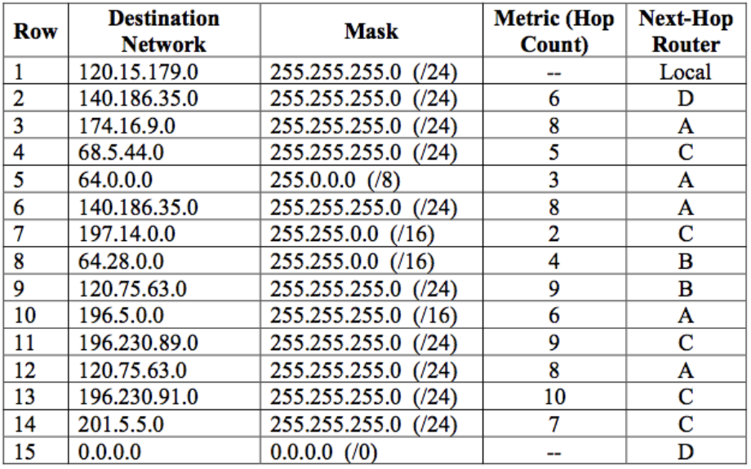


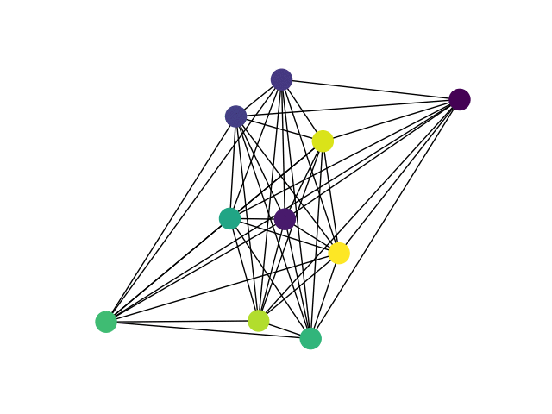
Router B
Router B
Router B
Host C
Host C
Host C
Host C
Router A
Router B
Router A
Router B
Router B
Router B
Router A
Router A
Router A
Router B
Host C
Host C

Slide 22
Echo request and Echo reply
Gandi
{
Echo-request and echo-reply messages are designed for diagnostic purposes. It is mainly used to determine whether two systems (host or router) can communicate with each other. A host or router can send an echo-request message to another host or router, The host or router that receives the echo-request message then will create an echo-reply message and return it back to the original sender.
}
@
Echo request
Echo reply
0
4
8
12
16
20
24
28
32
Type = 0 or 8
Code = 0
Checksum
Identifier
Sequence Number
Optional Data

Slide 23
Timestamp request / reply
Gandi
{
Timestamp request and timestamp reply is the same as echo request and echo reply but with slightly modified format. It is mainly used to determine the roundtrip time needed for an IP datagram to travel between two systems.
}
@
@
Type: 13 (Request) | Code: 0 | Checksum
Identifier |  | Sequence Number
Original Timestamp
Receive Timestamp
Transmit Timestamp
Type: 13 (Request) | Code: 0 | Checksum
Identifier |  | Sequence Number
Original Timestamp (09:30:00)
Receive Timestamp (0)
Transmit Timestamp (0)
Type: 14 (Reply) | Code: 0 | Checksum
Identifier |  | Sequence Number
Original Timestamp (09:30:00)
Receive Timestamp (09:30:01)
Transmit Timestamp (09:30:02)
Type: 14 (Reply) | Code: 0 | Checksum
Identifier |  | Sequence Number
Original Timestamp (09:30:00)
Receive Timestamp (09:30:01)
Transmit Timestamp (09:30:02)
RTT = Receive Timestamp - Original Timestamp +
(Transmit Timestamp – Receive Timestamp)
RTT = 09:30:01-09:30:00+(09:30:02-09:30:01)
= 1 second + 1 second
= 2 seconds

Slide 24
Router Solicitation / Advertisement
Gandi
{
}
Router Solicitation / Advertisement is used when a host need to send data between each other in a network. It mainly obtains the routing information of nearby router and those connected to it.
Host A
Hey ! Are there any routers out there?
(Solicitation)
Type: 9 | Code: 0 | Checksum
Number of addresses | Address entry size | Lifetime
Router Address 1
Address Preference 1
Router Address 2
Address Preference 2
…..
Type: 10 | Code: 0 | Checksum
Identifier |  | Sequence Number
Router Address: The address of the router
Address Preference: It is used to define the ranking of the router. Address preference level 0 means that that router is selected as the default router.
Yes ! I am here. Take my routing information.
(Advertisement)
Yes ! I am here. Take my routing information.
(Advertisement)
Identifier: Filled by source host.
Sequence Number: Filled by source host.
Router A
Router B

Slide 25
4
ICMP Issues :
DDoS attacks

Slide 26
What is a DDoS attack?
Grebinnyi Anton
Ping of Death
Smurf Attack
In Distributed DoS (DDoS) attack, attackers try to exhaust internet bandwidth or RAM in attempt to crash the target system.
Flood Attack

Slide 27
Ping of Death Attack
Grebinnyi Anton
IP fragments
@
…
Ping of death is an attack-type that objectifies the ICMP and the TCP (Transmission Control Protocol) and is quite possibly the most undermining of all ICMP attacks.
An attack happens when a fashioned packet that is greater than what the protocol can acknowledge is sent. A fashioned packet will be excessively huge for the PC making it restart or crash when the PC has a go at sending back a destination inaccessible ICMP message.
Attacker
Target
System
Ping of Death Packet
IP header
ICMP header
ICMP data
+
20 bytes
8 bytes
>= 65,508 bytes

Slide 28
Smurf Attacks
Grebinnyi Anton
1
2
3
The Smurf attack is a type of DDoS attack that exploits the ICMP to overwhelm a target network with massive amounts of traffic. The attacker sends a large number of ICMP ping messages to network routers, using the spoofed source IP address of the victim machine.
The routers respond by sending ICMP echo reply packets back to the victim machine, which floods it with more traffic than it can handle.
4
X

Slide 29
Flood Attack
Grebinnyi Anton
ICMP flood attack is a type of DDoS attack in which attacker tries to overwhelm the target with ICMP echo-requests.
By flooding the target with request packets, the network is forced to respond with an equal number of reply packets. This causes the target to become inaccessible to normal traffic.

Slide 30
5
Questions

Slide 31
How many parameters are included in the ICMP message header and where is it located?

Slide 32
In which layer does ICMP work?

Slide 33
Which type of DDOS attacks is the most undermining one?

Slide 34
6
References

Slide 35
A. S. Tanenbaum and D. J. Wetherall, "Computer Networks," 5th Edition.
GeeksforGeeks, "Types of ICMP (Internet Control Message Protocol) Messages," [Online]. Available: https://www.geeksforgeeks.org/types-of-icmp-internet-control-message-protocol-messages/
DataFlair, "ICMP Protocol," [Online]. Available: https://data-flair.training/blogs/icmp-protocol/#:~:text=ICMP%20Query%20Messages%3A&text=It's%20used%20to%20send%20a,sends%20an%20echo%2Dreply%20message.
IBM, "ICMP Type and Code IDs," [Online]. Available: https://www.ibm.com/docs/en/qsip/7.4?topic=applications-icmp-type-code-ids
Tutorialspoint, "What are the Types of ICMP Message Types," [Online]. Available: https://www.tutorialspoint.com/what-are-the-types-of-icmp-message-types
Omnisecu, "ICMP Parameter Problem Messages," [Online]. Available: https://www.omnisecu.com/tcpip/icmp-parameter-problem-messages.php
Cloudflare, "Internet Control Message Protocol (ICMP)," [Online]. Available: https://www.cloudflare.com/learning/ddos/glossary/internet-control-message-protocol-icmp/
Huawei, "ICMP," [Online]. Available: https://info.support.huawei.com/info-finder/encyclopedia/en/ICMP.html
TechTarget, "ICMP (Internet Control Message Protocol)," [Online]. Available: https://www.techtarget.com/searchnetworking/definition/ICMP
Copyprogramming, "ICMP Header and IP Header Checksum Calculations," [Online]. Available: https://copyprogramming.com/howto/icmp-header-and-ip-header-checksum-calculations#icmp-header-and-ip-header-checksum-calculations
Stack Overflow, "ICMP Echo Checksum," [Online]. Available: https://stackoverflow.com/questions/20247551/icmp-echo-checksum
Wallarn, "What is a Ping of Death Attack? " [Online]. Available: https://www.wallarm.com/what/what-is-a-ping-of-death-assault#:~:text=Ping%20of%20death%20is%20a%20strategy%20for%20DoS,death%20attack%20is%20otherwise%20called%20a%20teardrop%20attack.
Security Gladiators, " Smurf Attack. " [Online]. Available: https://securitygladiators.com/threat/ddos/smurf-attack/
NETSCOUT," ICMP Flood. " [Online]. Available: https://www.netscout.com/what-is-ddos/icmp-flood#:~:text=Because%20an%20ICMP%20flood%20attack%20overwhelms%20the%20targeted,in%20the%20case%20of%20more%20concerted%20attack%2C%20DDoS.
Illustrations, tables, schemas : Kozich Dziyana
GIF images: https://giphy.com

